Slide 1
Intro to Comp Coding Mar 23 2024 Greg Lakomski

Slide 2
Trees and Graphs
Graph theory is one of the most important topics in discrete math and programming. According to me, the most crucial step in solving graph theory problems is visualizing them properly.
Read the question very carefully for determining what type of graph it is:

Slide 3
Trees and Graphs
This is the first and probably one of the most important steps. The question will tell you whether the graph is a tree, or it is a graph with only one cycle, or multiple disjoint cycles, or just a random graph.
A tree has so many nice properties that you can exploit.
There are subtle ways of saying that the given graph is a tree. For example: "The graph has N nodes. It is not disjoint and has N-1 edges", "The graph doesn't contain any cycles", "In the given directed graph, each node has one and only one parent", etc.
Similarly, if there is only one cycle, then you can imagine the graph as having a ring with many trees hanging from the nodes of the ring.
Once the graph has been identified, identify what the question wants from you:

Slide 4
Trees and Graphs
In this step, you try to figure out what is it that the question wants you to do. Does it have something to do with shortest paths? If yes, then are all the weights positive? If not, then clearly it can't be direct Dijkstra. What else can we do? Bellman Ford? Floyd-Warshall?
You should be able to eliminate approaches fast.
Graph problems can also include simple traversal, flows, disjoint unions, etc. The best way to figure out what is applicable is method of elimination. The size of input data tells a lot about the algorithm to be used. This is because graph algorithms span the whole range of complexities, from linear to exponential. So, if you know you need a linear or a quasi-linear algorithm for the given size of input, you can simply eliminate many of the algorithms.

Slide 5
Trees and Graphs
If you have identified that the graph is not a tree, a lot of algorithms can further be eliminated like
heavy-light decomposition
https://cp-algorithms.com/graph/hld.html
dynamic programming on trees

Slide 6
Todays Problem
10255 - The knight's Tour

Slide 7
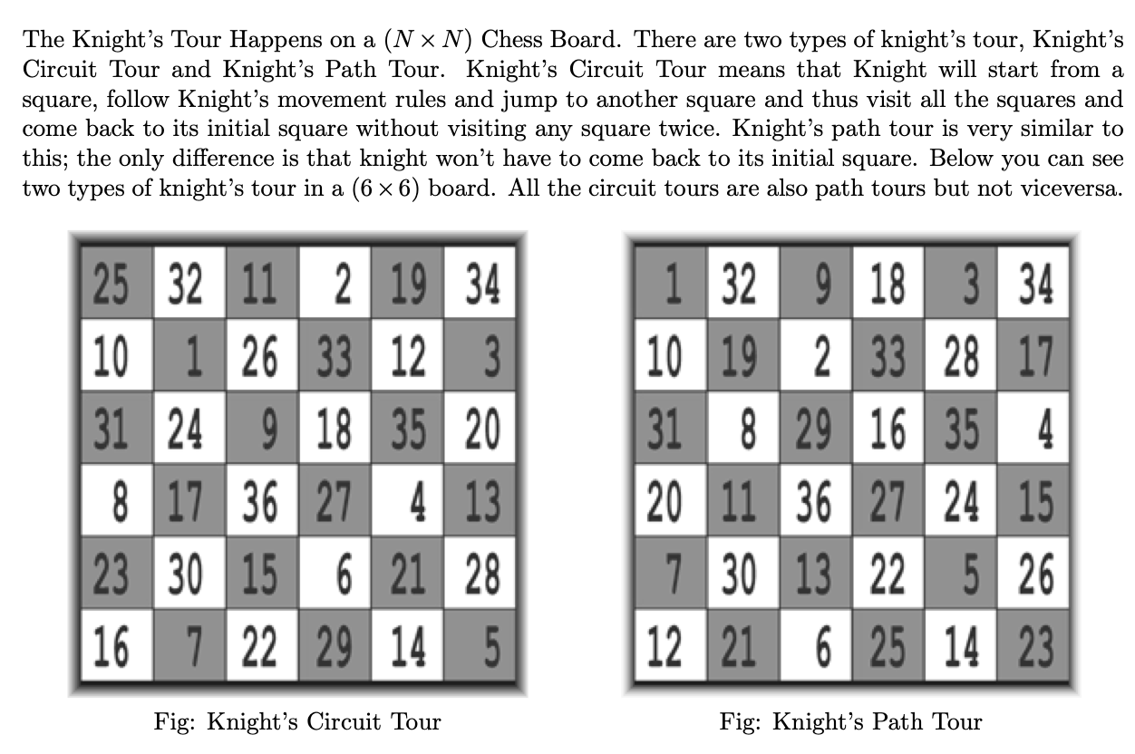
Knights Tour

Slide 8
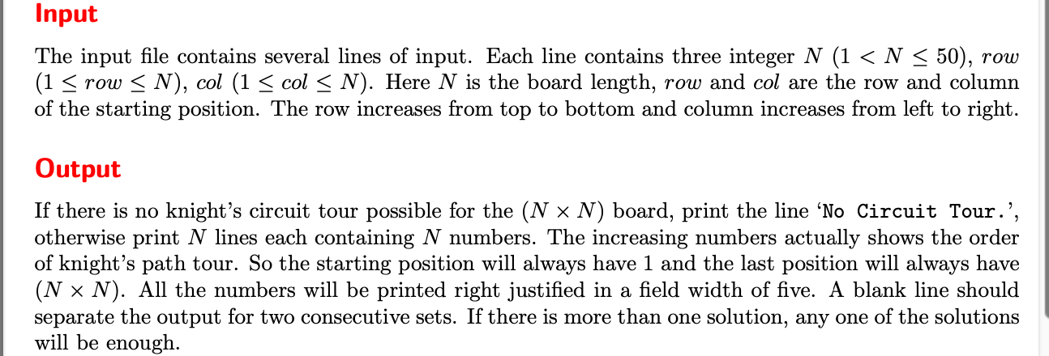
Knights TOur

Slide 9
Knights TOur
Two variants
Knight finishes on starting square
Knight finishes on any square
One is a PATH
One is a CYCLE
Which is which?

Slide 10
Knights Tour
Can the knight do a tour? GOOD QUESTION!
One key thing about knights. They always land on a square that is a different color that they started!
In our graph they form what is called a BIPARTITE GRAPH
nodes separated into two sets
members of the same set are never adjacent
there is no odd cycles - the number of nodes in a cycle must be even
this means that the number of squares on the chess board must be even
so if our chessboard has two odd sides then no knights tour
NOTE: There are tour problems with rectangular boards

Slide 11
Knights Tour
Lets look at size 1 – no tour
Size 2 – no tour
Size 3 – Trick Question ☺
Size 4 – Interesting question

Slide 12
Board size 4 by X
Outer rows can only go to inner rows
We alternate between colors as knight moves
BUT we also have to have a bipartite graph
Since there are black and white squares on both inner and outer rows that means that we cannot create a graph with black nodes on one side and white nodes on the other
Therefore NO TOUR EXISTS for board with on side = 4

Slide 13
OK What about our problem
BRUTE FORCE
Generate all tours and see if tour meets constraints
EEEKKKKK!!!!
Backtracking ?

Slide 14
Backtracking
If all squares are visited print solution
Else
a) Add one of the next moves to solution vector and recursively check if this move leads to a solution. (A Knight can make maximum eight moves. We choose one of the 8 moves in this step).
b) If the move chosen in the above step doesn't lead to a solution then remove this move from the solution vector and try other alternative moves.
c) If none of the alternatives work then return false (Returning false will remove the previously added item in recursion and if false is returned by the initial call of recursion then "no solution exists" )

Slide 15
Knights tour
Constraints:
Back to starting point
Can only visit each square only once
Move like knight

Slide 16
Knights tour
So you have to have a way of knowing whether a node was already visited ( part of node struct or make a pair or a tuple
Use tuple over pair since you can use decomposition C++ 20

Slide 17
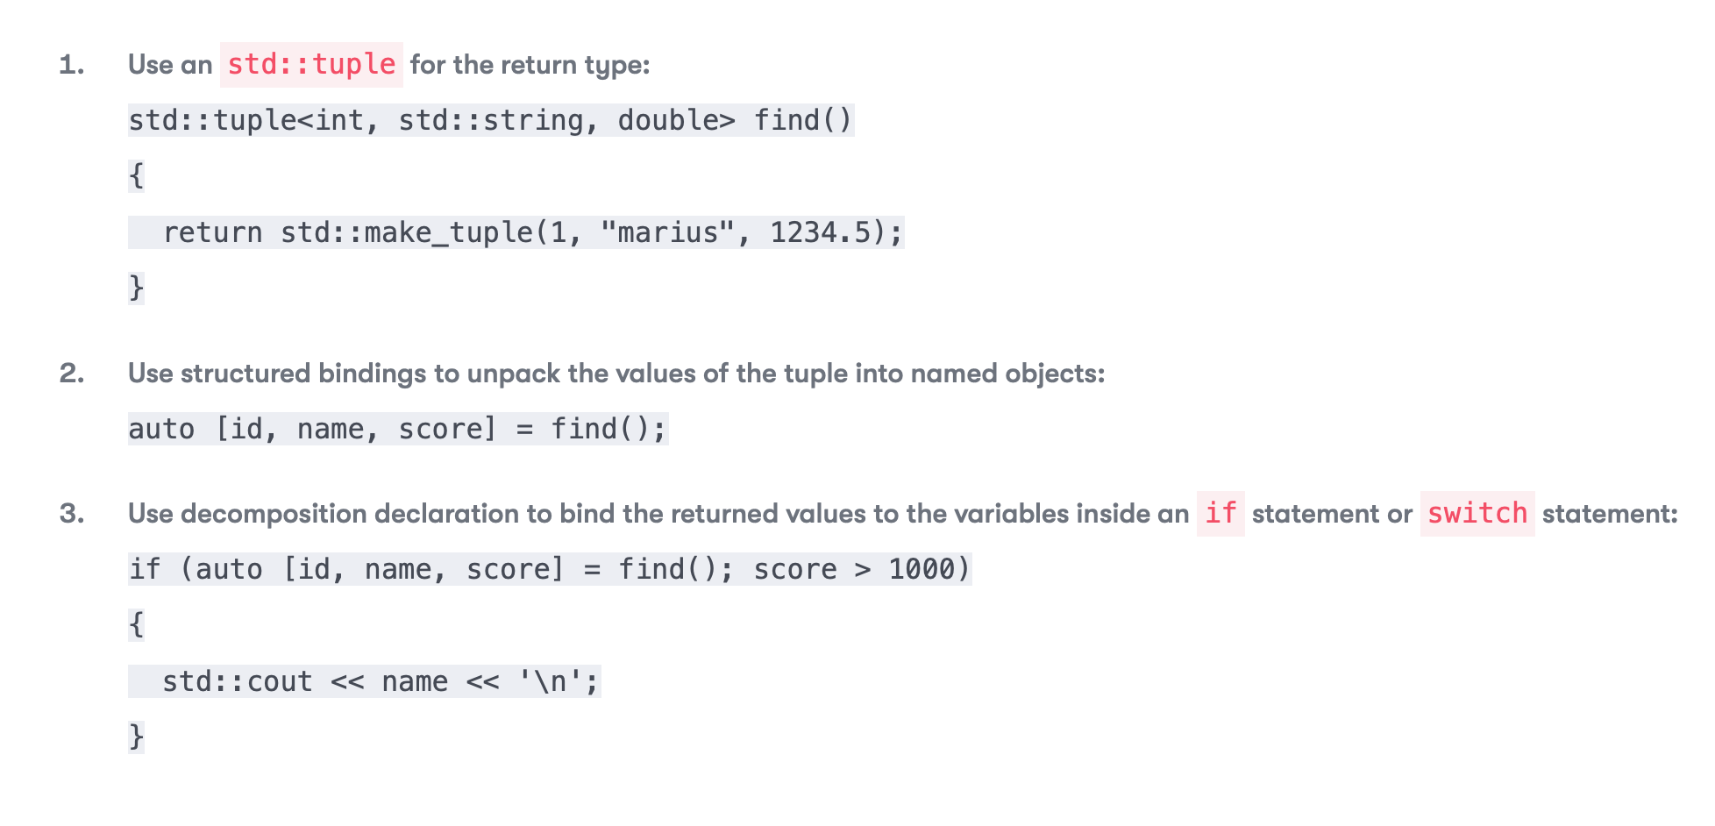
Structured Bindings

